Slide 1
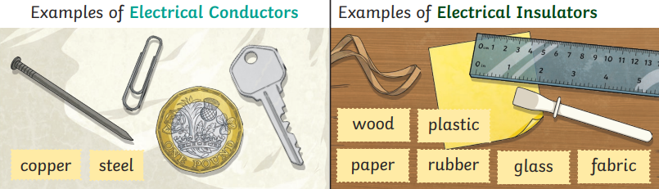
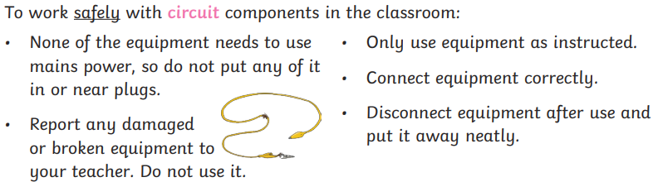
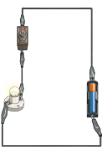
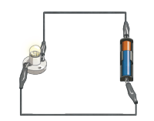
Electricity | The flow of an electric current through a material, e.g. from a power source through wires to an appliance.
Simple circuit | A pathway that electricity can flow around. It is based around wires and a power supply. Examples of components (parts) you can add in to a circuit are bulbs, switches, buzzers and motors.
Light bulb | Lights up in a complete circuit
Cell | Normally, we would call this a battery but scientifically, this is a cell. Two or more cells joined together form a battery.
Wire | Used to connect the different components in the circuit together.
Buzzer | Makes a noise in a complete circuit.
Switch | Used to turn other components in the circuit on or off.
Motor | Produces movement in a complete circuit.
Series circuit | A circuit where the components are connected in a loop. Electricity flows through each component in a single pathway.
Conductor | A conductor of electricity is a material that will allow electricity to flow through it.
Insulator | Materials that are electrical insulators do not allow electricity to flow through them.
How has electricity changed the way we live?
Appliances
Many everyday appliances rely on electricity for them to work. Some appliances use mains electricity (are plugged into a socket) and others have a battery to make them work. Examples of mains-powered appliances include toasters and televisions. Battery-powered appliances can include mobile phones and torches.

