Slide 1
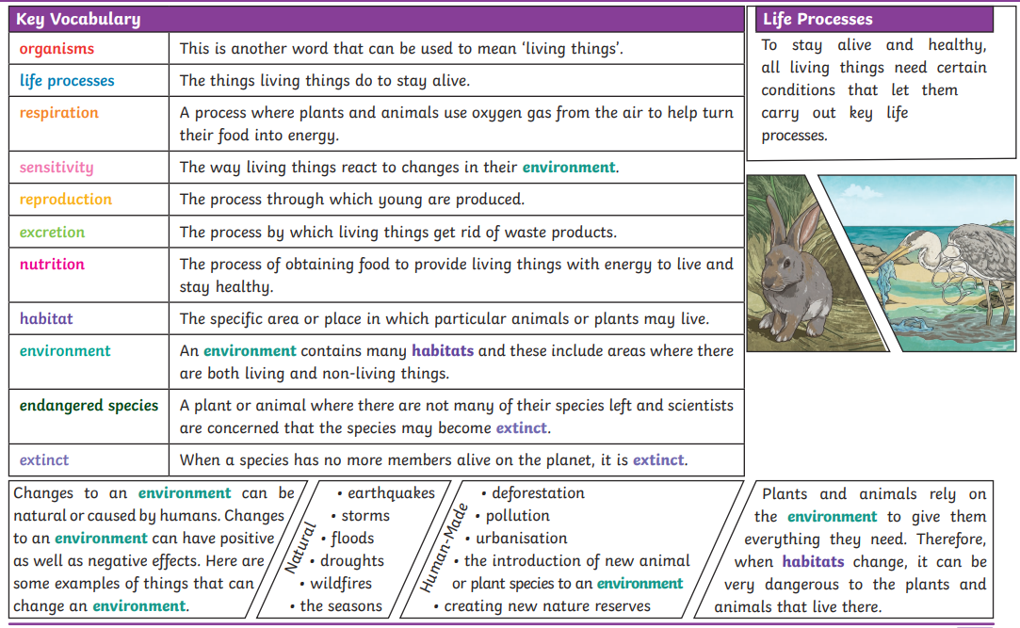
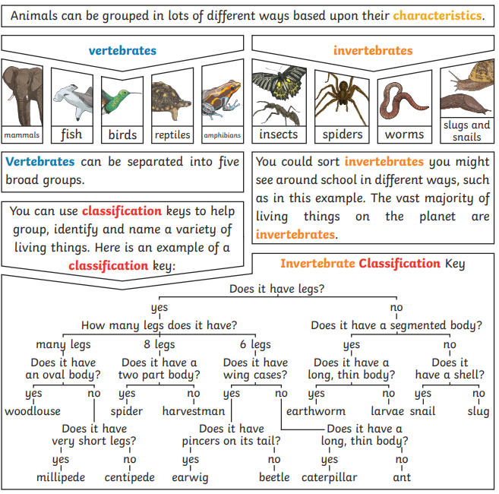
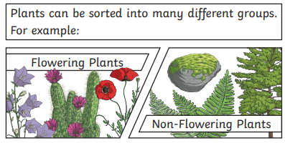
Can we use the classification keys to identify all the animals that we caught pond dipping?
Living things and their habitats - classification
Environment | Where a living thing lives.
Non-flowering plants | Plants that do not produce flowers.
Flowering plants | Plants that produce flowers.
Vertebrate animals | Animals that have a backbone such as: fish, birds, mammals, amphibians, reptiles.
Invertebrate animals | Animals that do not have backbones such as: snails, worms, slugs, spiders, insects.
Deforestation | The action of clearing a wide area of trees.
Population increases | When they amount of people in an area grows.
Nature reserves | A protected area of importance where you can observe or study wildlife.

