Slide 1
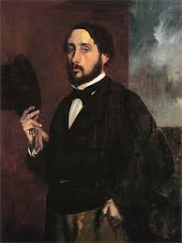
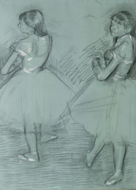
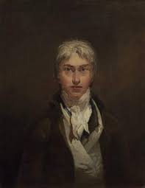
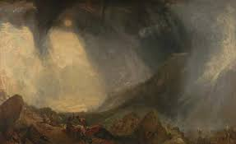
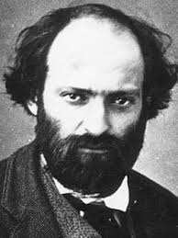
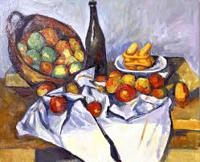
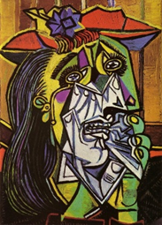
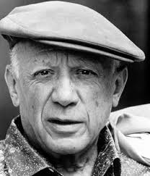
Art Knowledge Organiser
How is there freedom in the arts?
Sticky Vocabulary
Achievement | A thing that has been done successfully with effort, skill or courage.
Blending | Smoothly mixing two colours or shades together.
Community | Group of people who live in the same area, share similar interests, or work together towards a common goal.
Diversity | Differences in people or items
Free Stroke | Make a line or mark without worrying about it being perfect
Influence | Having an effect on something or someone.
Impressionism | Impressionist artists were not trying to paint real life, but an impression of their subject.
Sketch | A rough or unfinished drawing or painting.
Still life | A painting or drawing of an arrangement of objects.
Perspective | The appearance of objects with regards to their position and distance.
Primary colour | Any group of colours which other colours can be obtained from by mixing.
Secondary colour | A colour resulting from mixing two primary colours.
Sketch | A quick, simple drawing that shows the main ideas of something.
Tertiary colour | A colour resulting from the mixture of two secondary colours.
Tones | A shade or variety of a colour.
Values: Respect and Trust
Edgar Degas
Date born and died:
Place of birth: America.
Significant works: The Dancer
Influence: Influenced by what he saw in dance.
Joseph Turner
Date born and died: 1775-1851
Place of birth: England
Significant works: The Snowstorm
Influence: Influenced by emotions in landscapes
Cezanne
Date born and died: 1775-1851
Place of birth: England
Significant works: The Snowstorm
Influenced by cubism
Pablo Picasso
Date born and died: 1881-1973
Place of birth: Spain
Significant works: The Weeping Woman
Influenced by cubism.
Art – Year A
Year 3 and 4
Timeline of
artistic periods
Romanticism
(1780-1900)
Modern
(1900-1945)

Slide 2
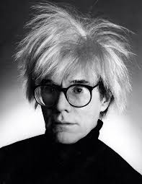
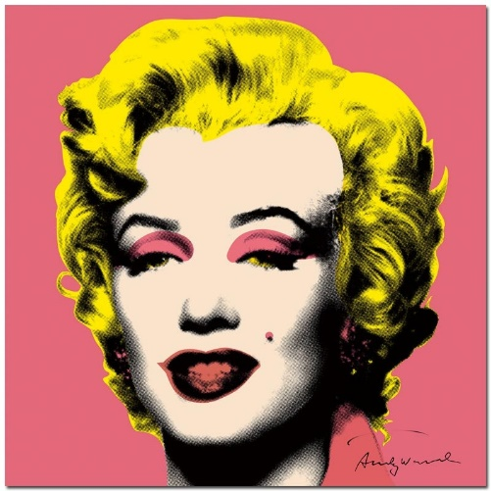
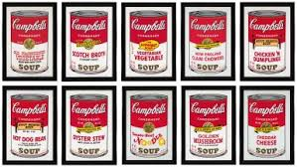
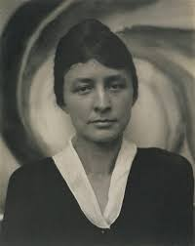
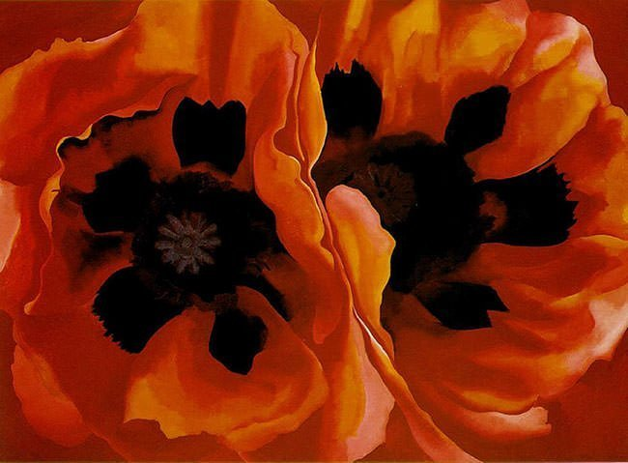
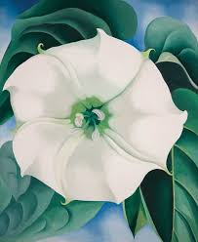
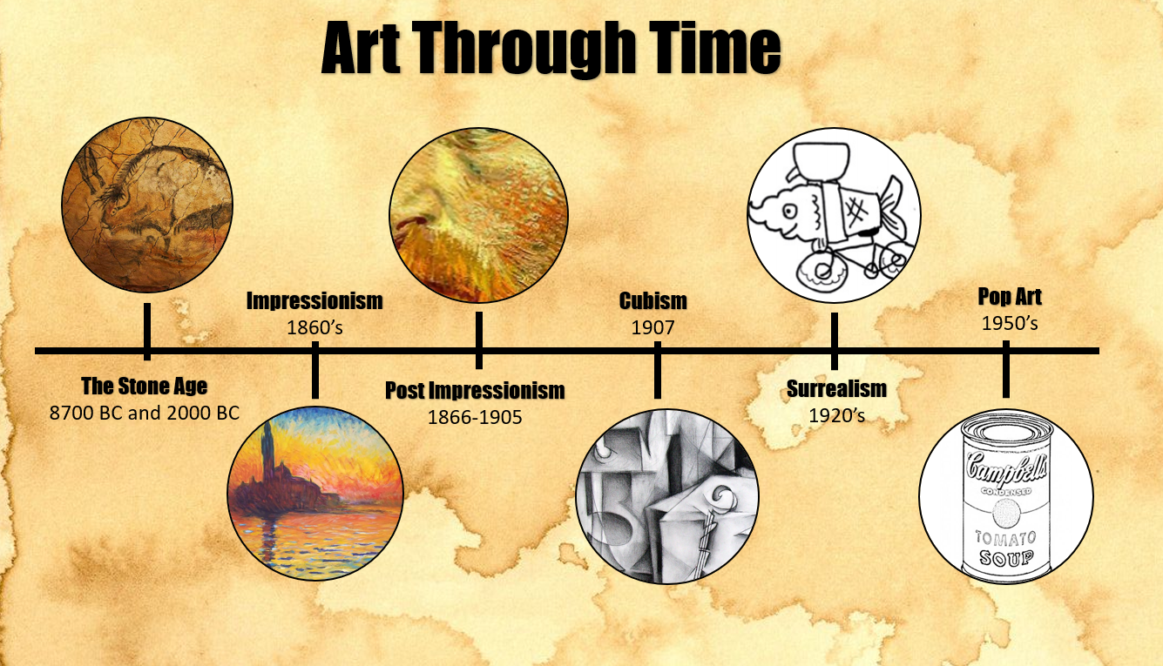
Art Knowledge Organiser
What is the purpose of the arts?
Sticky Vocabulary
Abstract | Modern art which does not represent images of our everyday world. Uses colour, line and shape to represent things.
Achievement | A thing that has been done successfully with effort, skill or courage.
Community | Group of people who live in the same area, share similar interests, or work together towards a common goal.
Consumerism | Thinking that having many things is important.
Diversity | Differences in people or items
Influence | Having an effect on something or someone.
Impressionism | Impressionist artists were not trying to paint real life, but an impression of their subject.
Intaglio | Ink is applied beneath the surface like engraving or etching.
Pattern | A design in which lines, shapes or colours are repeated. The part that is repeated is a motif.
Printing | A process of making images that can be transferred onto other surfaces.
Tone | The lightness or darkness of a colour.
Texture | The surface of something.
Values: Respect and Trust
Andy Warhol
Date born and died: 1928 - 1987
Place of birth: America.
Artistic style: pop art and modern art.
Significant works: Marilyn Monroe, Campbell’s soup.
Influence: Influenced others by making them aware of consumerism.
Georgia O’Keefe
Date born and died: 1887 – 1986
Place of birth: America
Artistic style: moved away from impressionism and into abstract art.
Significant works: Oriental Poppies
Influence: Painted nature to show how it made her feel not what it looked like.
Timeline of artistic periods
Baroque period (1602-1750)
Romanticism
(1780-1900)
Medieval Art
Renaissance (1300-1602)
Classical period
(1750-1820)
Modern
(1900-1945)
Contemporary
(1942-present)
Art – Year B
Year 3 and 4

Slide 3
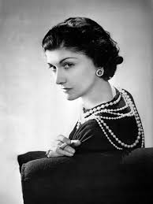
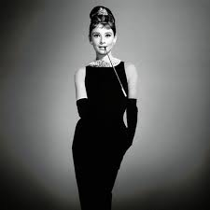
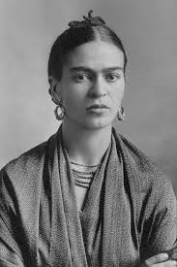
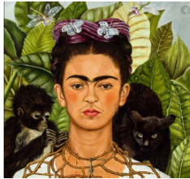
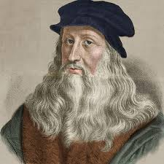
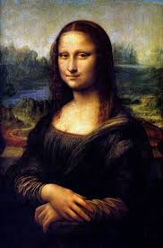
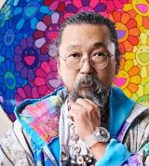
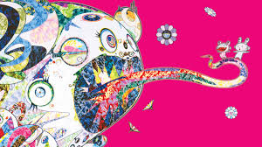
Art Knowledge Organiser.
What do the arts tell us about our diverse world?
Sticky Vocabulary
Achievement | A thing that has been done successfully with effort, skill or courage.
Architect | Someone that designs buildings
Community | Group of people who live in the same area, share similar interests, or work together towards a common goal.
Critique | An opinion of someone else's work.
Diversity | Differences in people or items
Equality | Everyone having equal chance
Influence | Having an effect on something or someone.
Individuality | What makes someone different
Native Art | Looking at traditional styles of artwork.
Portrait | A painting of the head, face and shoulders
Prejudice | A view that is not based on reason or experience
Rights | Freedom to do something.
Surrealism | Artistic style which allows you to draw imagined things.
Symbolism | Artistic style where drawn items symbolise feelings.
Values: Perseverance and Aspiration
Coco Chanel (1883- 1971)
French designer
She influenced women’s fashion.
She made the little black dress famous.
Frida Kahlo (1907 -1954)
She is born in Mexico.
Her artist style is influenced by surrealism and symbolism.
Painted Self Portrait with thorns
Leonardo Di Vinci (1452-1519)
Born in Italy.
Painted the Mona Lisa.
Drew ideas from his imaginary for machinery in the future.
Takashi Mua kami
Hew as born in 1962 in Japan
He is influenced by Japanense culture and art.
Timeline of artistic periods
Art –
Year A
Year 4 and 5
Renaissance (1300-1602)
Baroque period (1602-1750)
Classical period
(1750-1820)
Romanticism
(1780-1900)
Modern
(1900-1945)
Contemporary
(1942-present)

Slide 4
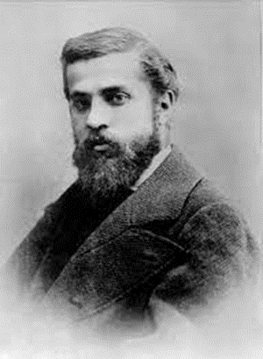
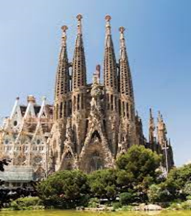
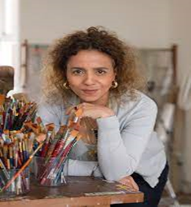
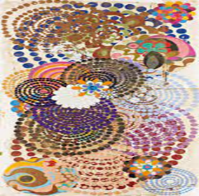
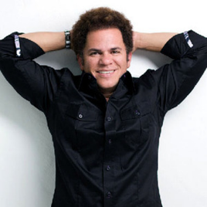
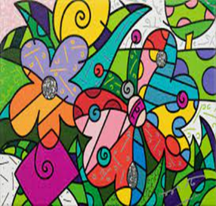
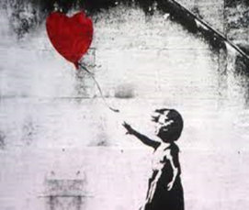

Art Knowledge Organiser
Is better to stand out or fit in?
Sticky Vocabulary
Achievement | A thing that has been done successfully with effort, skill or courage.
Architect | Someone that designs buildings
Community | Group of people who live in the same area, share similar interests, or work together towards a common goal.
Consumerism | Thinking that having many things is important.
Cubism | A style of painting that shows angles
Diversity | Differences in people or items
Graffiti | Graffiti is writing, drawings, or paintings applied to public surfaces—often walls, often without permission.
Influence | Having an effect on something or someone.
Lithograph | A form of printing used by Banksy
Pattern | A design in which lines, shapes or colours are repeated. The part that is repeated is a motif.
Printing | A process of making images that can be transferred onto other surfaces.
Sculpture | A piece of artwork that is three-dimensional.
Stencil | A thin sheet of card, plastic, or metal with a pattern or letters cut out of it, used to produce a design.
Values: Perseverance and Aspiration
Gaudi was a Spanish architect who designed the Roman Catholic church, Sagrada Familia.
He was born in 1850 and died in 1926.
Beatriz Mihazes is a Brazilian artist born in 1960.
She was influenced by Kandinsky.
She wants people to see the diversity in her work.
Romero Britto is a Brazilian artist born in 1963.
Romero Britto was influenced by cubism.
Banksy is a graffiti artist who prints his work onto walls. He painted ‘There is always hope’.
No-one knows his real identity.
Art –
Year B
Year 5 and 6
Timeline of artistic periods
Renaissance (1300-1602)
Baroque period (1602-1750)
Classical period
(1750-1820)
Romanticism
(1780-1900)
Modern
(1900-1945)
Contemporary
(1942-present)

