Slide 1
Supporting Children with Anxiety
Dr. Catherine Eaton
Derbyshire Educational Psychology Service
Notes:
SE

Slide 2
This afternoon we’re going to
learn about what anxiety is and to deepen our understanding in this area
discuss what anxiety might look like
learn how best to help

Slide 3
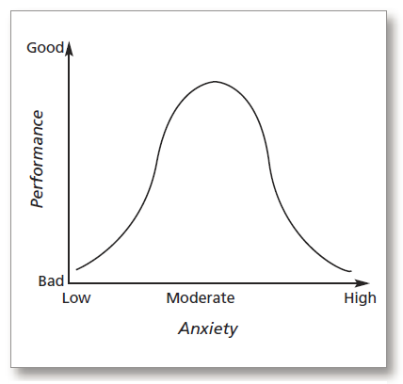
What is Anxiety?
A natural biological response within the body that helps us survive
Can be helpful in times of stress or danger
Helps us perform at our peak
But when there is too much anxiety our performance suffers

Slide 4
Some Anxiety is Normal
Feeling anxious is a natural part of everyday life.
An absence of stress can cause boredom.
If we have too much stress, then we can become upset and have difficulty coping with our daily lives.
Notes:
In fact it helps to stop us feeling bored and lethargic but if our level of anxiety goes too high it can affect our performance on every day tasks.
For most of us a comfortable level of stress will enable us to function efficiently – at an optimum level we are likely to be alert and self-assured.

Slide 5
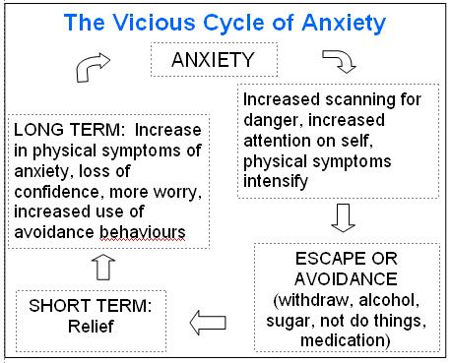
Understanding Anxiety
Three parts to anxiety:
  Body – physical response
  Thoughts – self-talk
  Actions –behaviour
To help a child or young person with anxiety, all three parts must be addressed

Slide 6

Flight – Fright – Freeze

Slide 7
What Does Anxiety Look Like?
Reluctance to attend school
Excessive mood swings
Impaired social relationships
Possibility of self-harm
Withdrawn
Challenging behaviour
Reduced concentration skills
Increased inactivity and distractibility
Eating disorder
Display physical symptoms such as nausea, palpitations etc
Develop obsessions or phobias
Experience disturbed sleep patterns therefore tired in school

Slide 8
Why do Young People Feel Anxious?
Some children have inherited an anxious personality (emotional sensitivity) and are ‘worriers’.
Some have learnt anxious responses from others
Some may be experiencing long or short term stress in their lives
Impact of pandemic and lockdowns

Slide 9
Risk Factors
Some young people are more prone to be anxious than others.
There are a number of risk factors which affect a young person’s ability to cope with anxiety:
Genetic predisposition
Anxiety in the home environment
Learning difficulties and low IQ
Temperament/personality
Physical illness
Inconsistent or harsh parenting
Abuse of all forms
Experience of trauma
Bereavement, separation and other forms of loss/unresolved loss
Hostile and rejecting relationships
Socio-economic disadvantage
Family difficulties
Drug and alcohol issues in the family
Neurodiversity (e.g., Autism., ADHD)

Slide 10
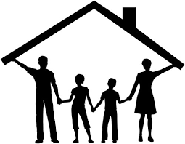
Protective factors
Consistent home and family routine
High family support
Experiencing fewer stressors
High self-esteem and feelings of worth
Consistent physical activity
Sufficient social skills
Internal locus of control
High socio-economic status
High social support
Secure attachment style
Active coping strategies
Feelings of self-worth
Sense of school belonging

Slide 11
Lessons from lockdown
Some children and young people were happier learning at home
Some children and young people thrived in smaller groups in school
Some children and young people felt significant sense of loss and identity crisis at not being in school

Slide 12
Research findings – (Eaton 2022)
Relationships
Opportunities to shine
Positive interactions
Sense of identity
Routine and structure

Slide 13
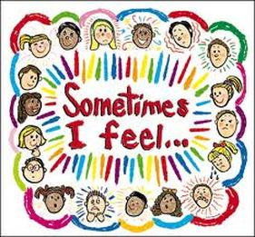
Wave 1:
For all children and young people
Promote emotional literacy skills
  Emotional recognition, emotional vocabulary, awareness of body language/facial expressions
Model helpful thoughts and positive thinking styles
Celebrate strengths and promote positive self-concept

Slide 14

Promoting Resilience
Resilience – translated as ‘bouncing back’. Typically, someone is resilient when they have endured a difficult event or series of events and have managed to overcome these obstacles.
Resilience is for ALL – not only for ‘high risk’ vulnerable groups we all need to deal with tricky events at some point
An organisation known as ‘Boing Boing’ www.boingboing.org.uk have developed a Resilience Framework which translates the resilience research base into everyday practice and concepts. This is divided into five strands
‘Basics’ ‘Belonging’ ‘Coping’ ‘Core Self’ ‘Learning’

Slide 15
Wave 2:
Additional Support when difficulties are emerging
Relaxation skills
Healthy thinking and self-talk
Calming tools
6 Step Approach

Slide 16
The 6 Step Approach
Step 1: The C/YP firstly needs to understand what anxiety is; when it is normal and when it is a serious issue
Step 2: The C/YP needs to understand that they are not on their own
Step 3: The C/YP needs to understand more about their own experiences of anxiety
Step 4: The C/YP needs to understand how anxiety occurs
Step 5: The C/YP needs to understand that they are in control of their reactions
Step 6: The C/YP needs to work on the link between thoughts, feelings and behaviours

Slide 17
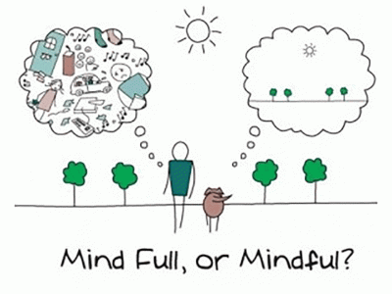
Relaxation Skills
Deep breathing – hand exercise
Relaxation/Mindfulness
Calming tools – help the young person to build up a repertoire (e.g. read a book, listen to music, talk to someone you trust…)
Sport/Exercise

Slide 18
Targeted Emotional Literacy Skill Development
Improve emotional recognition and regulation
  Talk about the brain, the anxiety response and how the body responds
  Talk about what is happening in the body
  Emotional self-awareness
  Identify triggers
  Improve emotional vocabulary
  Identify physical sensations
  Monitor progress

Slide 19
Wave 3:
Individual Intervention
  Within school intervention
  Develop a trusting relationship
  Relationships take time
  Build rapport through positive experiences and engaging activities
  Focus on individual’s personal experience of anxiety (i.e. triggers, physical response, thoughts and beliefs, develop personal thinking and coping strategies)
  Referral to specialist services

Slide 20
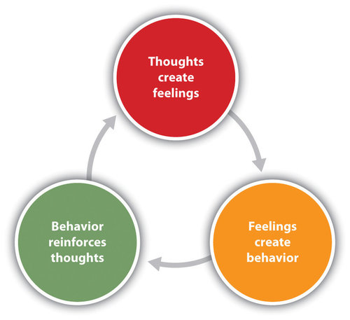
Direct Intervention
Cognitive Behaviour Therapy approaches are shown within systematic reviews and randomized clinical trials (RCTs) to be effective to support anxiety
For example – Lang et al. (2010) found that CBT is effective for treating anxiety in individuals with high functioning ASD.

Slide 21
Helpful vs Unhelpful Thoughts
Identify thoughts that lead to worry/fear
Recognising anxious thoughts allows them to be challenged
Identify physical response to these thoughts
Recognising the physical response allows for intervention at the earliest possible time
Identify how behaviour changes in response
Recognising how behaviour changes allows for it to be tracked and monitored for change

Slide 22
How to Respond to Panic?
Remain calm
Allow the young person to access a quiet place when possible
Speak in short and simple sentences, don’t overload with talk and don’t raise your voice or ask questions
Avoid any fast or sudden movements
Don’t face the young person and don’t enter their personal space
Guide the person through a simple physical task such as raising both arms overhead or counting to 10 on their fingers
Invite the person to breathe slowly with you in order to slow breathing – model slow, deep breaths
When possible provide a non-verbal distraction such as a calming app on a tablet (e.g. relax app)

Slide 23
First steps
Ask open, curious questions
Be empathetic (e.g., ‘that sounds really hard for you’)
Ensure your child feels listened to

Slide 24
Avoidance isn’t helpful - graded exposure is essential.
Involve the child in creating the plan
Use curious questions before and after each step
Try to make the plan fun and engaging
Be encouraging but your child needs to control the pace
Celebrate success

Slide 25
Resources
Youngminds.org
Get out of your mind and into your life - Ciarrochi

