Slide 1

Peace be with you
And also with you
At Wirksworth we show respect and care for others.

Slide 2
Respect no 3.
Monday 20th September

Slide 3
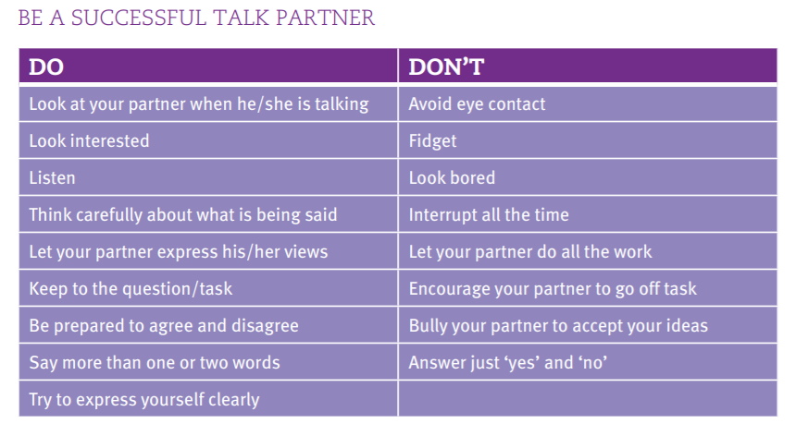
Talking partners- show respect

Slide 4
What does RESPECT mean?
Respect means that you accept somebody for who they are, even when they're different from you or you don't agree with them.
Respect is needed in all relationships.
Respect in your friendship builds feelings of trust, safety, and wellbeing.
Respect doesn't have to come naturally – it is something you learn.

Slide 5
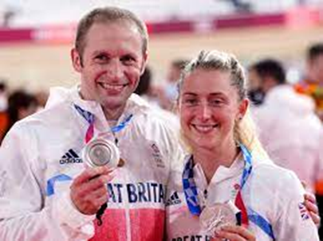
What we have learnt so far?
Week 1: who do you respect and why?

Slide 6
How are you different or the same as others?
Stand if……
* you have a brother
* you like football
* you enjoy chocolate
* you are a Christian
* you find math hard

Slide 7
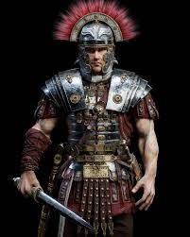
‘The Roman Centurion’
Why did the religious leaders want Jesus to help the centurion?
What were the similarities and differences between the centurion and Jesus?
How did they show their respect for one another?

Slide 8
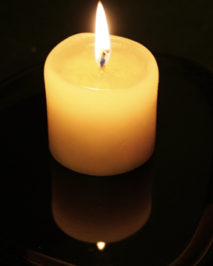

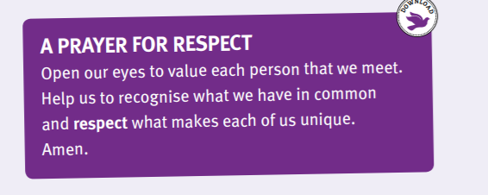
Reflection time

