Slide 1
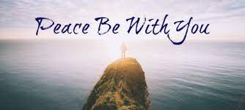
Peace be with you
And also with you
At Wirksworth we show respect and care for others.

Slide 2
Respect no 2.
Monday 13th September

Slide 3
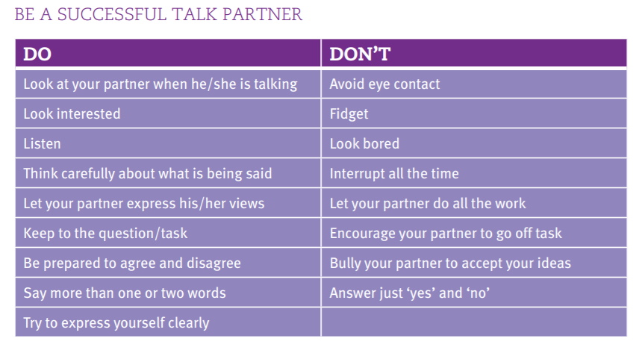
Talking partners- show respect

Slide 4
What does RESPECT mean?
Respect means that you accept somebody for who they are, even when they're different from you or you don't agree with them.
Respect is needed in all relationships.
Respect in your friendship builds feelings of trust, safety, and wellbeing.
Respect doesn't have to come naturally – it is something you learn.

Slide 5
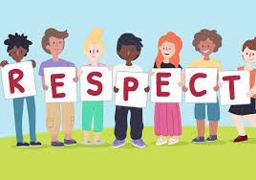
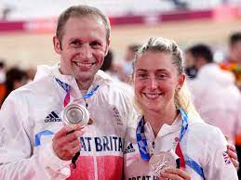
Who do you know that you really respect?
Why do you respect them?

Slide 6
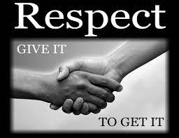
Respect poem
RESPECT IS…. Readiness to listen
Everyone being valued
Showing appreciation
Praying for people
Expressing opinions sensitively
Caring for our environment
Treating property carefully
Talk with a partner about which line you think is the best way of describing respect and why.

Slide 7
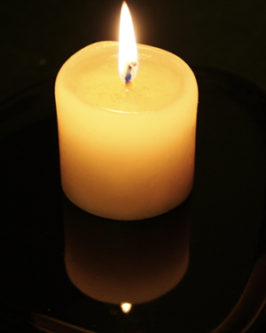

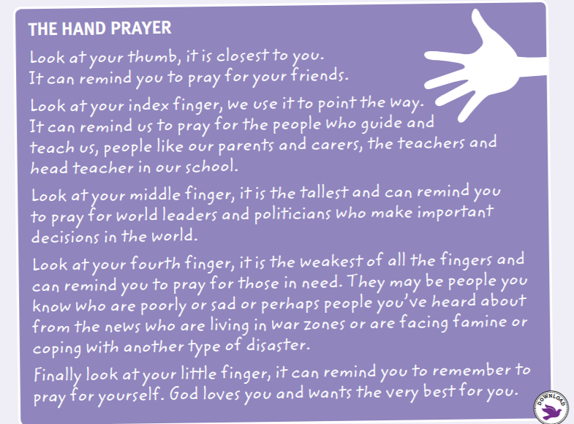
Reflection time
https://padlet.com/isabelwebb/vqz7nezzyw1w0cyw
Lets break into four groups and choose who we can pray for.

Slide 8

Make our own prayer

