Slide 1

Peace be with you
And also with you
At Wirksworth we show respect and care for others.

Slide 2
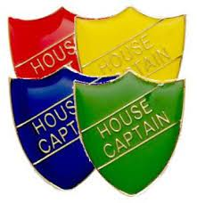
The houses
House Captains
Chatsworth- Mrs Meehan/ Mrs Mayman-Quick
Haddon- Mrs Wadey/Mrs Parker
Harwick – Mr Jenkins/ Mr Rourke
Royce- Miss Booth/ Mrs Varney
Nightengale – Miss Moore
Arkwright – Mrs Taylor/Mrs Davis

Slide 4



Slide 5
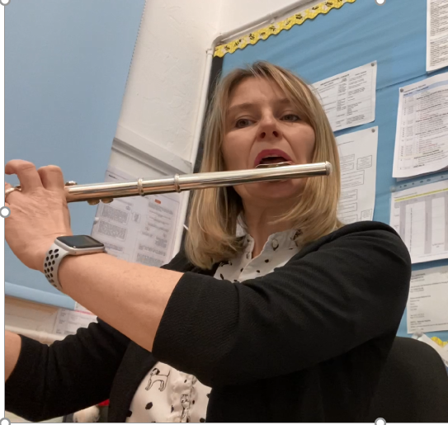
What instrument does Mrs webb play?

Slide 6
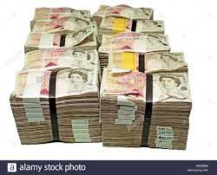
If Mrs webb had a choice about being taller or winning a million pounds what do you think Mrs webb would choose?

Slide 7

What is mrs webb’s favourite subject at school?

Slide 9
Respect no 1.
Monday 6th September

Slide 10

Homework
What is respect?

Slide 11
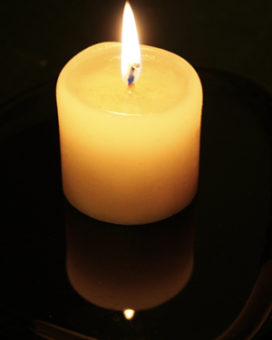

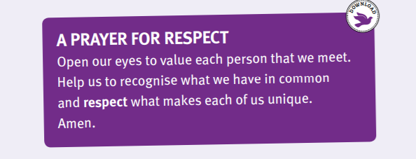
Reflection time

